Slide 1

Movie recommender system
By Kshitij Bhardwaj
Section –DS
University roll no. - 2013652
Roll no. - 31

Slide 2
Topic of discussion for today
Rise of the O.T.T
Why recommendation systems?
Type of recommendation systems
Popularity based
Top rated based
Content based
Crew based
Collaborative filtering based.

Slide 3
Rise of the “O.t.t”
the streaming services are the next Big thing
Pros of O.T.T : diverse content and rapidly growing audience
Digital streaming platforms overtook film entertainment to rank third-largest in “Indian Media & Entertainment” sector in 2019.
Covid-19 has further propelled the growth
Cinema halls are closed leading to audience shifting to O.T.T platforms.
Major players - Netflix, Amazon Prime, Disney+ etc.
according to the Global Internet Phenomena Report Netflix accounts for 11% of the total global internet traffic.
Notes:
With the rise of streaming services, over-the-top or OTT platforms are set to become the future of Indian Media & Entertainment industry. With their diverse content and growing audience, the digital platforms are anticipated to be the new normal for movie buffs. Digital streaming platforms overtook film entertainment to rank the third-largest Indian Media & Entertainment sector in 2019, according to the latest EY-FICCI Indian Media & Entertainment Report.
Covid-19 has further propelled the growth of a segment which was already booming. The closure of cinema halls has led to the emergence of OTT as the new big screen. However, the charm and experience of big screens for Indians will always remain, and they will return to the 70mm experience as soon as an accepted cure is out and things trickle back to normalcy.but this unprecedented situation has led to a complete overhaul of the ever-evolving dynamics of OTT business in India.
Major players in the market right now are Netflix, Amazon Prime, Disney +, HBO max , Hulu and apple T.V
Fun Fact- according to the Global Internet Phenomena Report Netflix accounts for 11% of the total global internet traffic.

Slide 4
Why Recommendation systems?
The rapid growth of data collection : a new era of information.
Data being used to create more efficient systems
Recommendation Systems are type of information filtering systems
provides items that are more relevant to the search item
They are used to predict the rating or preference that a user would give to an item.
Used by all the tech giants which rely on longer sessions of a user on their website.
Ex- Amazon, YouTube, Netflix, Prime Video etc.
Notes:
The rapid growth of data collection has led to a new era of information. Data is being used to create more efficient systems and this is where Recommendation Systems come into play. Recommendation Systems are a type of information filtering systems as they improve the quality of search results and provides items that are more relevant to the search item or are realted to the search history of the user.
They are used to predict the rating or preference that a user would give to an item. Almost every major tech company has applied them in some form or the other: Amazon uses it to suggest products to customers, YouTube uses it to decide which video to play next on autoplay, and Facebook uses it to recommend pages to like and people to follow. Moreover, companies like Netflix and Spotify depend highly on the effectiveness of their recommendation engines for their business and success.

Slide 5
Type of recommendation systems
Popularity based
Top rated based
Content based
Crew based
Collaborative filtering based.

Slide 6
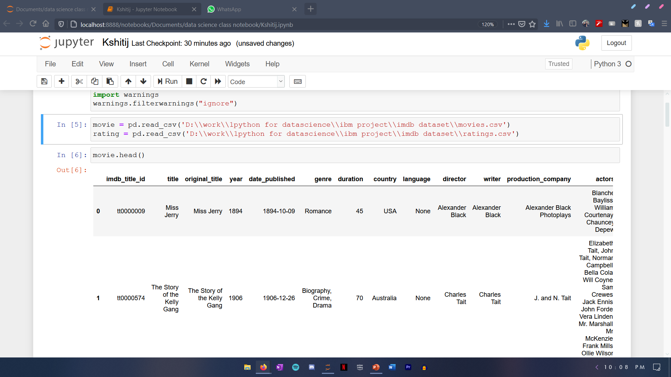
Now for the CF Based recommendation. We will use the IMDb movies extensive dataset. Let’s import the files:-

Slide 7
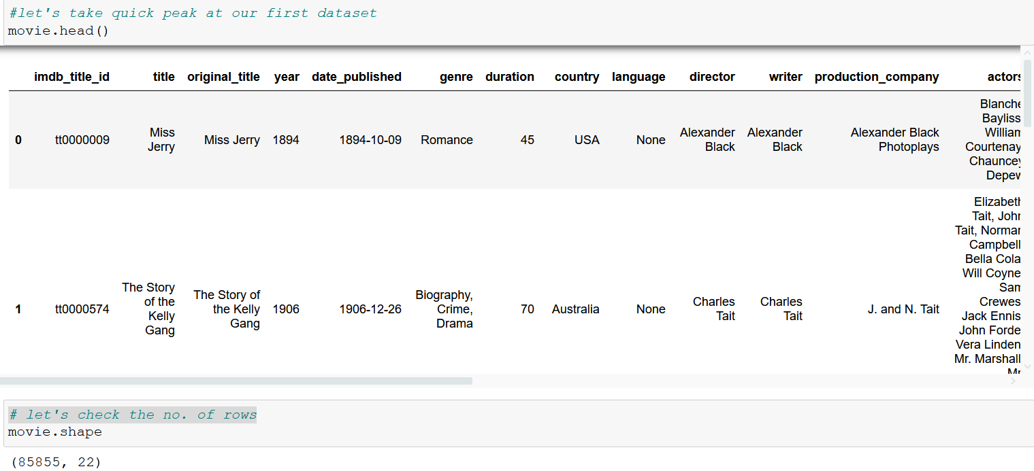

Slide 8
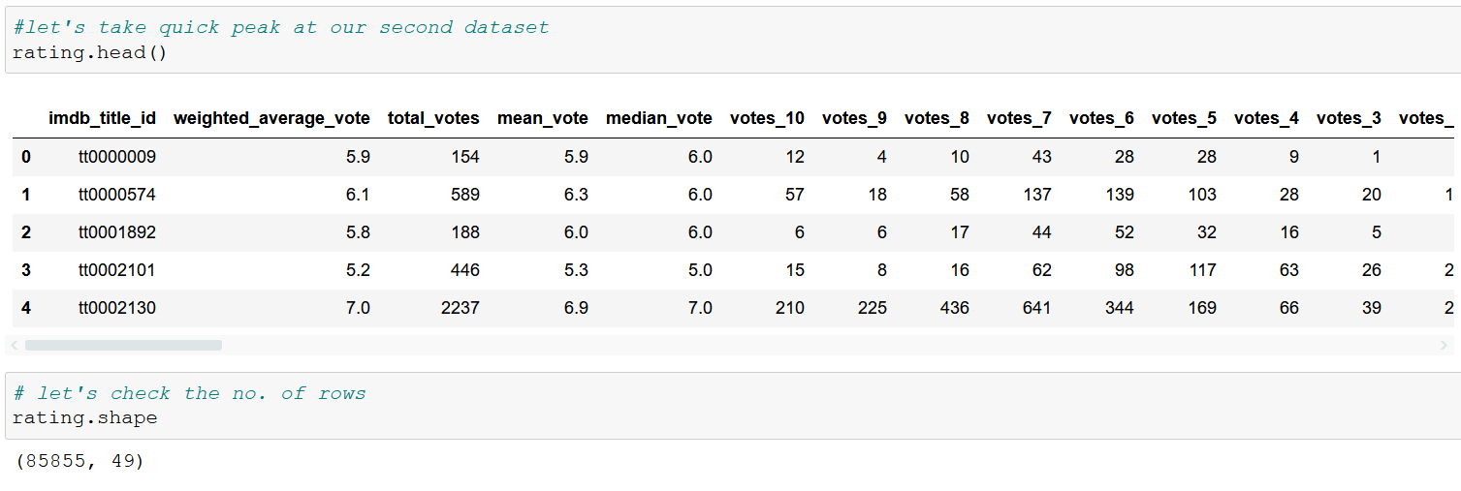

Slide 9
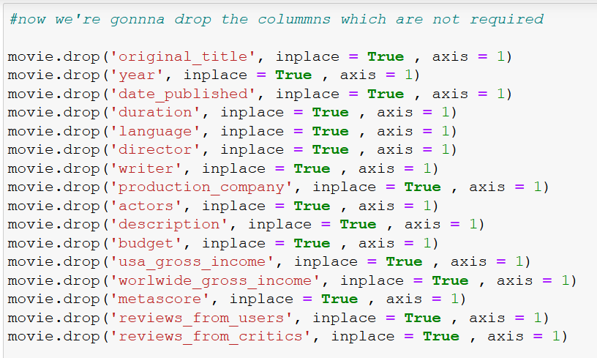

Slide 10
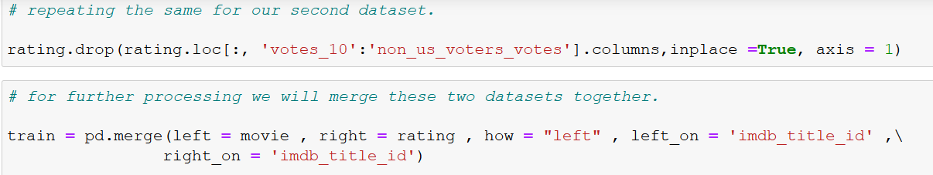

Slide 11
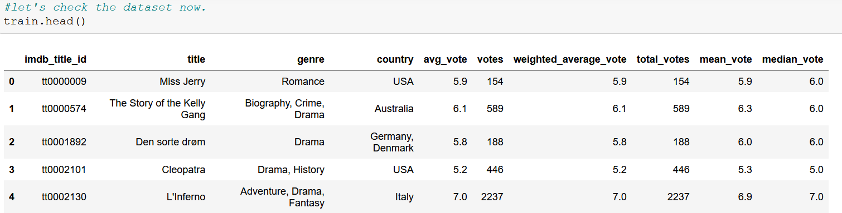

Slide 12
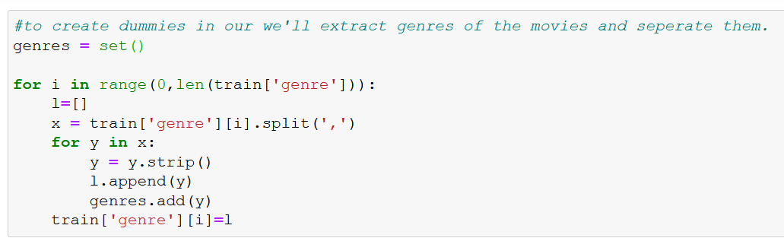

Slide 13
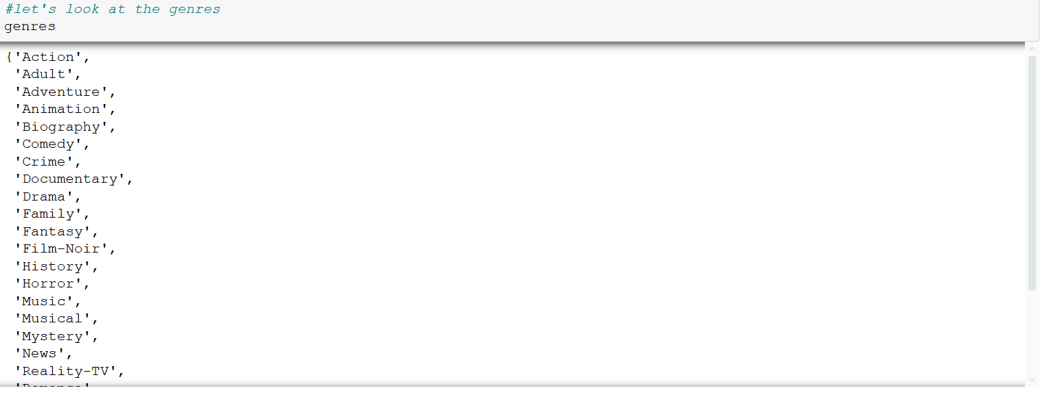

Slide 14
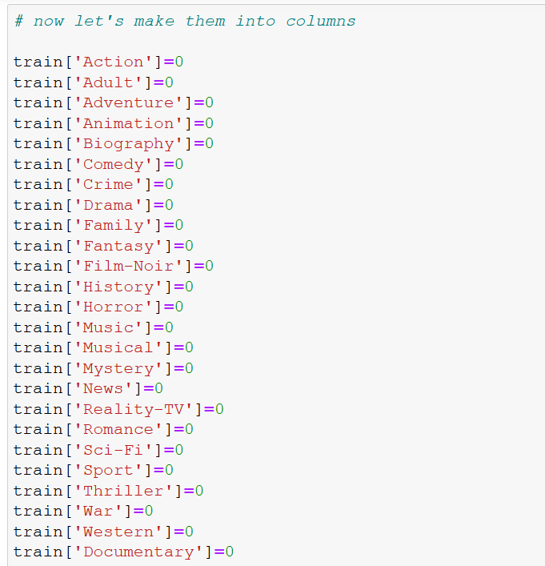

Slide 15
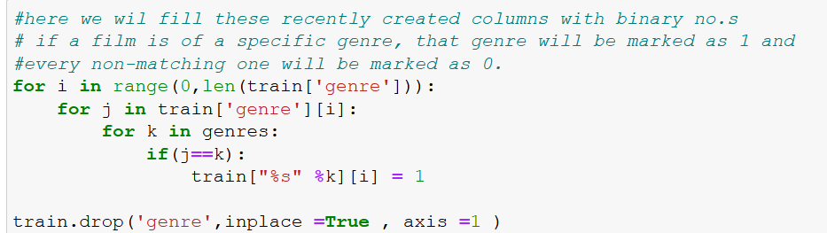

Slide 16
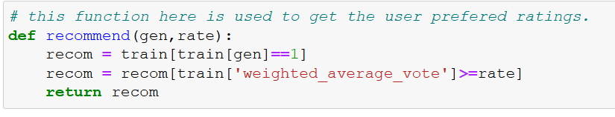

Slide 17
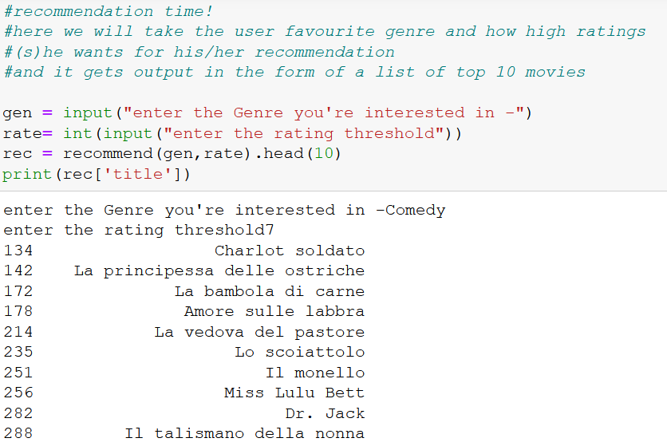

Slide 18

THANK YOU!

